Slide 1
Foundation of Marketing Analytics
max growth
By Prof.Vishal Chugh

Slide 2
What is Marketing Analytics?
It refers to the process of measuring, managing and analyzing marketing performance to maximize its effectiveness and optimize return on investment (ROI)

Slide 3






Resources/Tools Used

Slide 4
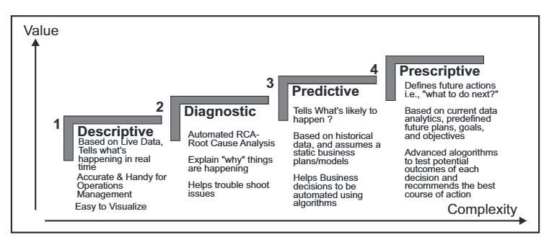
Types of Data Analysis

Slide 5
Scope of Marketing Analytics

Slide 6
Scope of Marketing Analytics
Customer Analytics
Campaign Analytics
Sales Analytics
Understanding customer demographics, customer preferences, behaviour and Life-Time Value
Measuring the effectiveness of advertising campaigns (Online and Offline) and optimizing marketing strategies
Tracking customer journey, conversion rates and sales trends

Slide 7
Scope of Marketing Analytics
Digital Analytics
Market Segmentation
Brand Analytics
Analyzing website traffic, social media engagement, email performance, SEO/SEM effectiveness and online advertising
Dividing the target market into distinct groups to customize marketing strategies
Monitoring Brand Awareness, reputation and customer sentiment

Slide 8
Scope of Marketing Analytics
Predictive Analytics
Pricing & ROI Analytics
Competitor Analysis
Using historical data to predict future customer behaviours, market trends and sales forecasts
Analyzing price sensitivity and optimizing pricing strategies to get expected ROI
Tracking competitor activities and optimizing pricing strategies

Slide 9
Types of Marketing Data

Slide 10
Internal and External Data
Internal Data
External Data
Data collected from within the organization through its own operations and customer interactions
Data obtained from outside the organization, gathered from third party sources, public databases or purchased research

Slide 11
Structured and Unstructured Data
Structured Data
Unstructured Data
Data that is organized and stored in a predefined format (like tables or databases) that is easy to search, analyze and process
Data that doesn’t have a predefined format, making it complex to collect, store and analyze without specialized tools

Slide 12
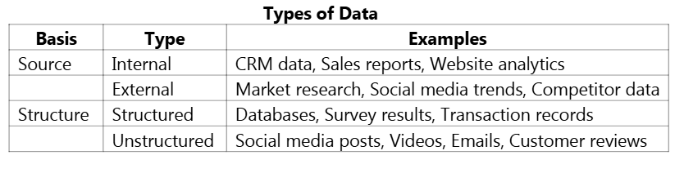
Types of Data Examples

Slide 13
Key Performance Metrics

Slide 14
Customer Lifetime Value (CLV)
CLV estimates the total revenue a business can reasonably expect from a single customer account throughout the business relationship
Interpretations
A Higher CLV means customers are more valuable to the business overtime
It helps businesses decide how much to invest in acquiring and retaining customers
Companies with higher CLV focus more on customer loyalty and satisfaction programs

Slide 15

Return on Marketing Investment (ROMI)
ROMI measures the efficiency of a marketing campaign in generating revenue compared to the cost invested in marketing
Interpretations
A Positive ROMI (>0%) indicates that the marketing efforts are profitable
A higher ROMI means marketing strategies are cost-effective

Slide 16

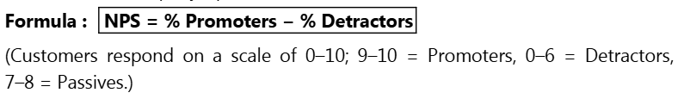
Net Promoter Score (NPS)
NPS measures customer loyalty by asking customers how likely they are to recommend a company’s product or service to others
Interpretations
A Positive NPS (>0) suggests that a company has more promoters than detractors
A high NPS (typically above 50) is considered excellent and signals strong customer satisfaction and brand loyalty
Helps identify areas for customer experience improvement

Slide 17

Customer Churn Rate (CCR)
Churn rate is the percentage of customers who stop using a company’s product or service during a given time frame
Interpretations
A high churn rate indicates dissatisfaction, strong competition or market fit issues
Lower churn rates reflect better customer retention and stronger loyalty
Monitoring churn helps businesses proactively address retention challenges

Slide 18
Let’s Solve an Example
Calculate the metrics for FireGrill QSR

Slide 19
Marketing Analytics Process

Slide 20
Steps in Marketing Analytics Process
Data Collection
Data Cleaning
Data Analysis
Customer Interactions
Sales Transactions
Website Traffic
CRM
Email Marketing Campaigns
Advertising Platforms
Identifying Outliers
Removing Duplicates
Correcting Errors
Standardize Format
Descriptive Analysis (Understand Past Data)
Diagnostic Analysis(Explaining why things are happening)
Predictive Analysis (forecast future trends)
Prescriptive Analysis (Recommend actions for improvement)

Slide 21
Steps in Marketing Analytics Process
Interpretation of Results
Data Visualization
Decision-Making
Identifying key trends
Correlations in Data
Understanding consumer behaviour
Opportunities for optimization
Key Metrics
Interactive Dashboards
Real-time updates from databases
Taking Data Driven Decisions
Fast and Accurate Results
Continuous Improvement and Monitoring

Slide 22
Always have user consent before collecting data

